Slide 1
DYNAMIC USER EXPERIENCE
DESIGN & USABILITY
STARTING SOON
Natali Panic-Cidic
natali.panic-cidic@ubisoft.com

Slide 2
DYNAMIC USER EXPERIENCE
DESIGN & USABILITY
Natali Panic-Cidic
natali.panic-cidic@ubisoft.com

Slide 3





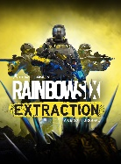






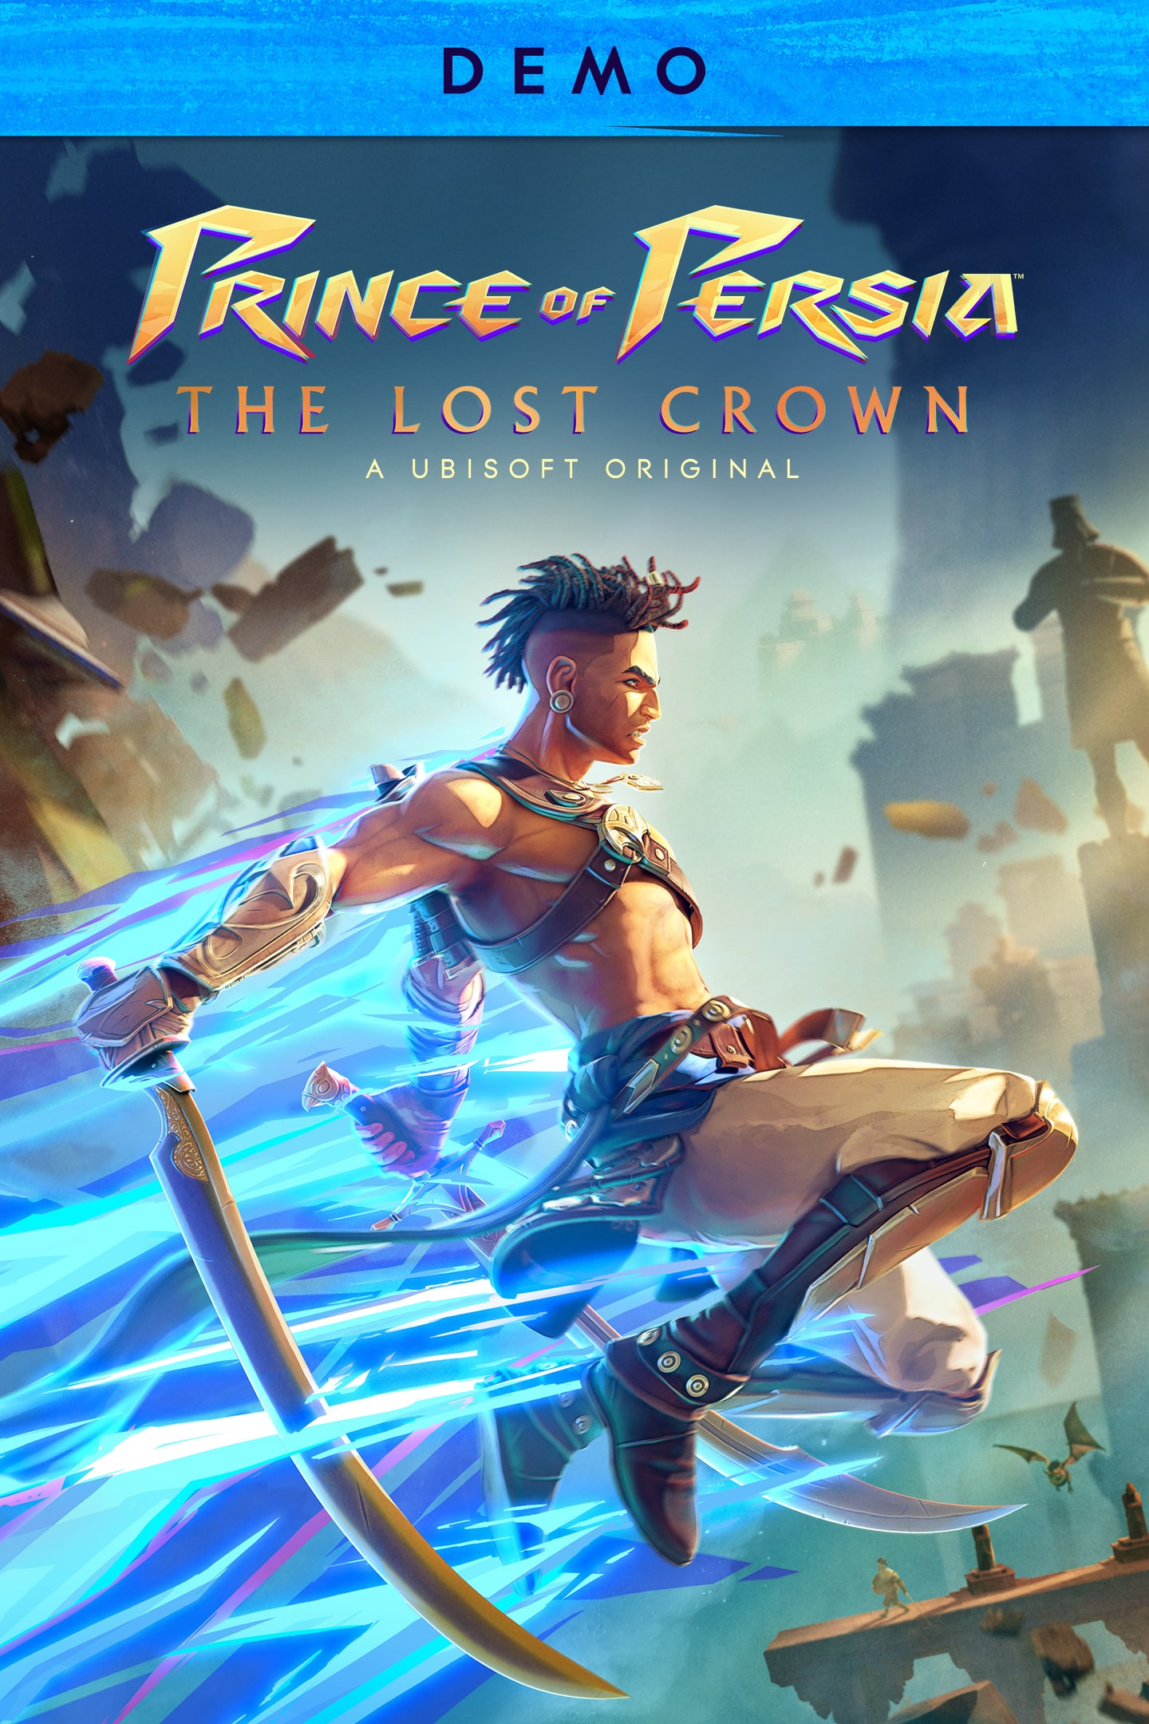



Natali Panic-Cidic
User Researcher - Ubisoft Düsseldorf
UXR Operations | Ubisoft Connect
Publications
Previously
Narrative Design
UX & Game Designer
User Research Coordinator
User Researcher
Education
(ongoing) PhD in Game User Research & Neuropsychology
M.A. specialization on Cognitive Studies & Player Psychology
B.A. specialization on Game Studies & Narratology
Conferences
Ubisoft Connect Credits
3

Slide 4
DO YOU PLAY?
WHAT DO YOU PLAY?
4

Slide 5

Outcome of this lecture
Introduce you to practical game industry models & interest you in a career as “user EXPERIENCE DESIGNER & RESEARCHER”.
Leveraging psychology
Understand player experiences
Improve usability
Tools to analyze or talk about games
5

Slide 6

AGENDA
Part 1
THE UX HIPPOGRIFF
Part 2
4 DOMAINS OF PLAY
Part 3
SELF-DETERMINATION THEORY (sdt) & PENS model
Part 4
Engines of play summary
Part 5
Q&A
6

Slide 7
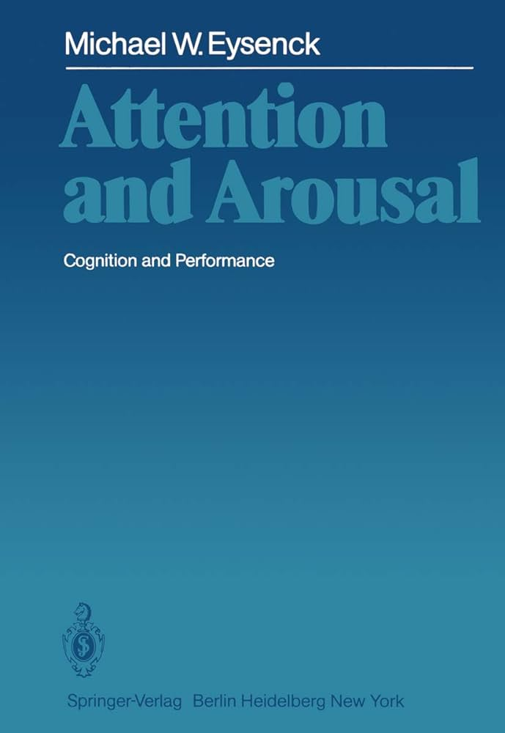
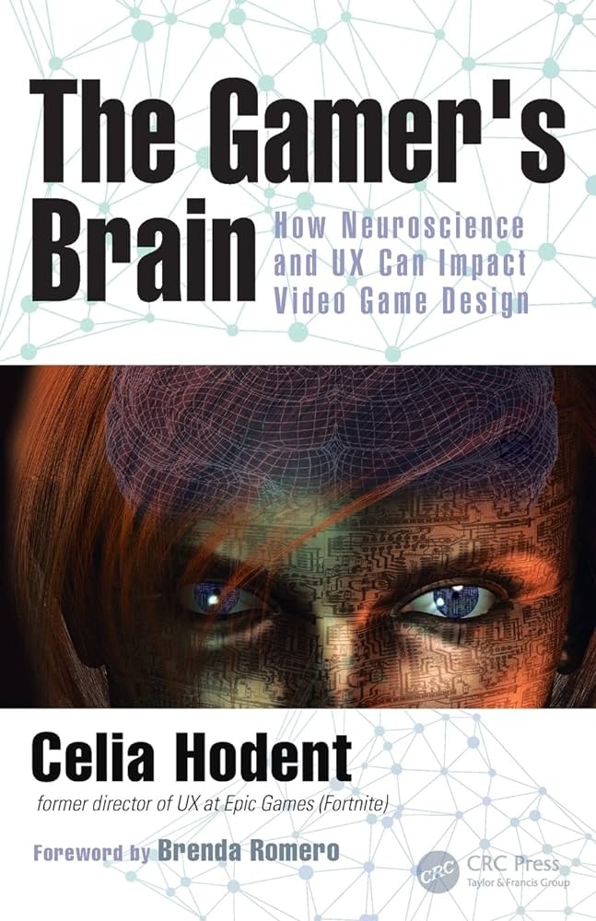
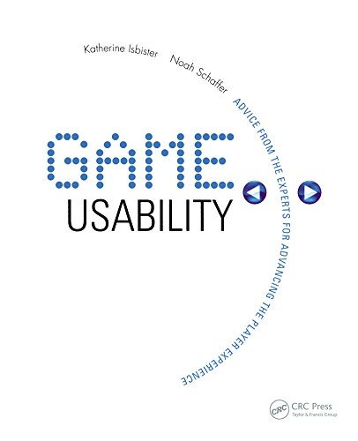



MAIN REFERENCES
books
papers
RICHARD RYAN et al. (2006)
Jason VandenBerghe (2016)
RICHARD RYAN (2017)
SDT PENS
Investment layers (60%, 15%, 5%)
PENS & MOTIVATION
Richard M. Ryan; C. Scott Rigby; Andrew Przybylski (2006). The Motivational Pull of Video Games: A Self-Determination Theory Approach. , 30(4), 344–360. doi:10.1007/s11031-006-9051-8
VandenBerghe, Jason (2014). [ACM Press the first ACM SIGCHI annual symposium - Toronto, Ontario, Canada (2014.10.19-2014.10.21)] Proceedings of the first ACM SIGCHI annual symposium on Computer-human interaction in play - CHI PLAY '14 - Engines of play. 476-476. doi:10.1145/2658537.2677953
Rogers, Ryan (2017). The motivational pull of video game feedback, rules, and social interaction: Another self-determination theory approach. Computers in Human Behavior, 73, 446–450. doi:10.1016/j.chb.2017.03.048
7

Slide 8

Game reference
Minecraft, 2009, microsoft
Sandbox game
Adventure
Limit is your imagination
Single & multi player
Multi-platform availability
8

Slide 9

THE UX hippogriff
Part 1

Slide 10

HALF
EAGLE
THE UX HIPPOGRIFF
HALF
LION

Slide 11
HALF
EAGLE
THE UX HIPPOGRIFF
HALF
LION
User Experience is just like a hippogriff! Let me explain.

Slide 12
THE UX HIPPOGRIFF
Usability
User experience definition
“The usability of a game is about its ease of use, how players interact with the game interface, and if this interaction feels satisfying.[…] It is about considering the ability of the system image (i.e. what the user perceives and interacts with) to clearly convey information about what the system means and how it can be used.” (Celia Hodent, Gamer’s Brain, p. 106-109.)
“[T]he game user experience entails how players perceive and understand a game, how they interact with it, and the emotions and engagement elicited via this interaction. [It consists of] two main components to consider: usability and engage-ability.” (Celia Hodent, Gamer’s Brain, p. 106.)
Engage-Ability
“[A] concept that accounts for how fun, engaging, and emotional a game is. […] [I]t means that you care about it, you are motivated to keep playing, your experience is emotional, you are immersed, you feel presence, and you are likely having fun, whatever “fun” means to you.” (Celia Hodent, Gamer’s Brain, p. 106.)
12

Slide 13
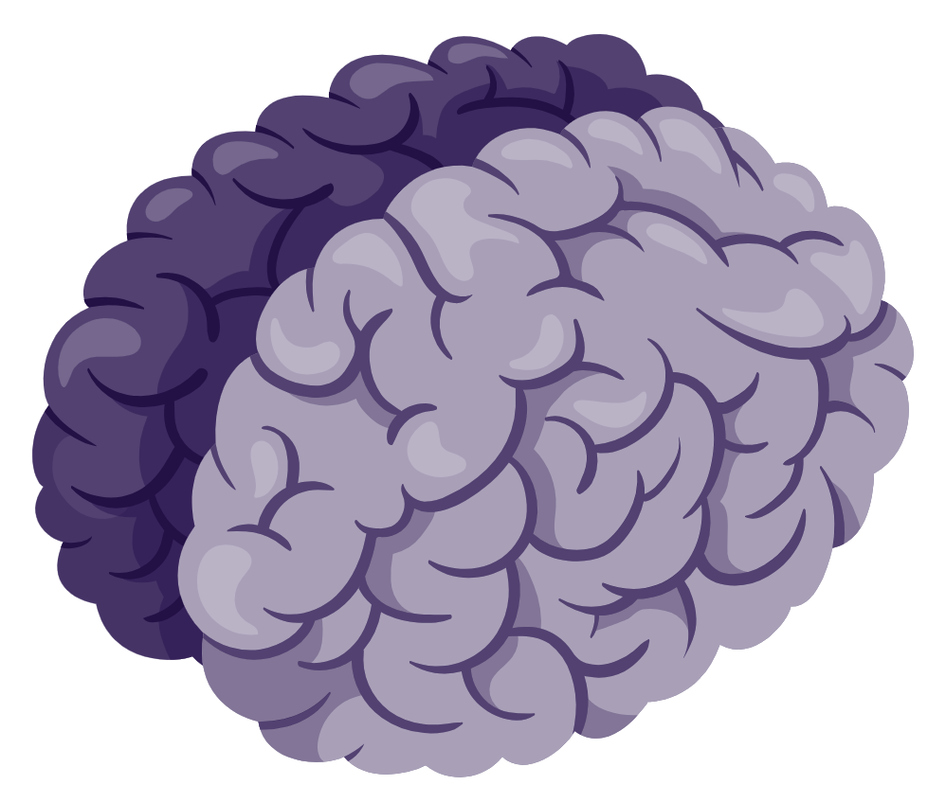
THE UX HIPPOGRIFF & LECTURE FOCUS
Motivation
Attention
Memory
Perception
Learning Principles
Emotion
13

Slide 14
Games are multimodal
A difficult medium to design for
PART 1 – the ux hippogriff
14

Slide 15
They engage our auditory, visual and linguistic brain regions. The higher the space for player expression, the higher the player experience.
But a very interesting one!
PART 1 – the ux hippogriff
15

Slide 16
MOTIVATION & ATTENTION VIA ENGINES OF PLAY VandenBerghe, Jason (2014)
Problem 1: The longer we play a game, the less we care about it matching our taste.
Problem 2: Player taste changes over time and we play for different reasons than we continue to play.
PERSONALITY THEORY (4 DOMAINS OF PLAY)
SATISFACTION THEORY (SDT)
Discovery
Evaluation
Use
Affinity
„I´ve heard of it“
„I tried it“
„I played it“
„I play it“
Player journey (time)
© N. Panic-cidic
PART 1 – the ux hippogriff
16

Slide 17
4 domains of play
Part 2

Slide 18
The longer we play a game, the less we care about it matching our taste.
what can you do about it?
Part 2 – 4 domains of play
18

Slide 19
PERSONALITY & INDIVIDUAL NEEDS
The Five-Factor Model
A widely and robustly examined model of personality
Part 2 – 4 domains of play
19
(O) penness to experience
How inventive and curious we are
Low-score: practical and conventional
High scores: creative and imaginative
(C) onscientiousness
How efficient and organized we are
Low-score: spontaneous and careless
High score: organized and self-directed
(E) xtraversion
How outgoing and energetic we are
Low-score: reserved and quiet
High score: outgoing and enthusiastic
(A) greeableness
How friendly and compassionate we are
Low-score: suspicious and hostile
High scores: trusting and empathetic
(N) euroticism
How sensitive and nervous we are
Low-score: emotionally stable
High score: anger and anxiety

Slide 20

PERSONALITY & INDIVIDUAL NEEDS
The Five-Factor Model
A widely and robustly examined model of personality
(O) penness to experience
How inventive and curious we are
Low-score: practical and conventional
High scores: creative and imaginative
(C) onscientiousness
How efficient and organized we are
Low-score: spontaneous and careless
High score: organized and self-directed
(E) xtraversion
How outgoing and energetic we are
Low-score: reserved and quiet
High score: outgoing and enthusiastic
(A) greeableness
How friendly and compassionate we are
Low-score: suspicious and hostile
High scores: trusting and empathetic
(N) euroticism
How sensitive and nervous we are
Low-score: emotionally stable
High score: anger and anxiety
Jason Vandenberghe 2016
OCEAN → 4 Factor Model
Part 2 – 4 domains of play
20

Slide 21
PERSONALITY & INDIVIDUAL NEEDS
Taste variation 6 individual variation of players
4 (5) domains of play correspond + correlate to the ocean model
(O) penness to experience
(C) onscientiousness
(E) xtraversion
(A) greeableness
(N) euroticism
Jason Vandenberghe
Veteran game designer
NOVELTY
HARMONY
CHALLENGE
THREAT
STIMULATION
Part 2 – 4 domains of play
21

Slide 22
4 domains of play – dimensions
Fantasy
Distinguishes open, imaginative experience from repeating, conventional ones.
Build
NOVELTY
Explore
Realism
Part 2 – 4 domains of play
22
Notes:
Novelty: Distinguishes open, imaginative experience from repeating, conventional ones.
Challenge: Deals with how much effort and/or self-control the player is expected to use.
Stimulation: Deals with the stimulation level and social engagement of play.
Harmony: Reflects the rules of player-to-player interactions.
Threat: Reflects the game‘s capacity to trigger negative emotions in the player.

Slide 23
4 domains of play – dimensions
Fantasy
Skilled
Deals with how much effort and/or self-control the player is expected to use.
Build
NOVELTY
Explore
Not work
CHALLENGE
Work
Realism
Less Skilled
Part 2 – 4 domains of play
23
Notes:
Novelty: Distinguishes open, imaginative experience from repeating, conventional ones.
Challenge: Deals with how much effort and/or self-control the player is expected to use.
Stimulation: Deals with the stimulation level and social engagement of play.
Harmony: Reflects the rules of player-to-player interactions.
Threat: Reflects the game‘s capacity to trigger negative emotions in the player.

Slide 24
4 domains of play – dimensions
Fantasy
Skilled
Build
NOVELTY
Explore
Not work
CHALLENGE
Work
Realism
Less Skilled
Multiplayer
Deals with the stimulation level and social engagement of play.
Calm
STIMULATION
Thrill
Part 2 – 4 domains of play
Solo
24
Notes:
Novelty: Distinguishes open, imaginative experience from repeating, conventional ones.
Challenge: Deals with how much effort and/or self-control the player is expected to use.
Stimulation: Deals with the stimulation level and social engagement of play.
Harmony: Reflects the rules of player-to-player interactions.
Threat: Reflects the game‘s capacity to trigger negative emotions in the player.

Slide 25
4 domains of play – dimensions
Fantasy
Skilled
Build
NOVELTY
Explore
Not work
CHALLENGE
Work
Realism
Less Skilled
Multiplayer
Cooperation
Reflects the rules of player-to-player interactions.
Calm
STIMULATION
Thrill
Mechanics
HARMONY
Context
Part 2 – 4 domains of play
Solo
Combat
25
Notes:
Novelty: Distinguishes open, imaginative experience from repeating, conventional ones.
Challenge: Deals with how much effort and/or self-control the player is expected to use.
Stimulation: Deals with the stimulation level and social engagement of play.
Harmony: Reflects the rules of player-to-player interactions.
Threat: Reflects the game‘s capacity to trigger negative emotions in the player.

Slide 26
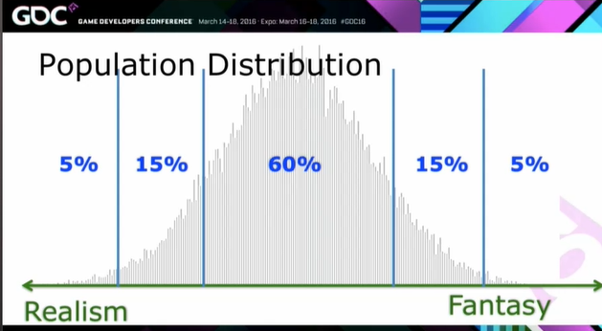



4 domains of play - distribution
Uses the standard distribution to map out three zones
NOVELTY
Fantasy
5%
15%
Build
60%
Explore
Low investment,
high population
High investment,
low population
Realism
STIMULATION
HARMONY
CHALLENGE
Multiplayer
Cooperation
Skilled
Calm
Thrill
Mechanics
Context
Not work
Work
Solo
Combat
Less Skilled
26

Slide 27

4 domains of play
NOVELTY
CHALLENGE
Fantasy
Skilled
Build
Explore
Not work
Work
60% - Does this feature exsist?
15% - Is it good? Will it be good?
Realism
Less Skilled
5% - Is this feature among the best in the world?
STIMULATION
HARMONY
Multiplayer
Cooperation
Calm
Thrill
Mechanics
Context
Solo
Part 2 – 4 domains of play
Combat
27
Notes:
60% - Does this feature exist?
15% - Is it good? Will it be good?
5% - Is this feature among the best in the world?

Slide 28
ENGINES OF PLAY VandenBerghe, Jason (2014)
PERSONALITY THEORY (4 DOMAINS OF PLAY)
Discovery
Evaluation
Use
Affinity
„I´ve heard of it“
„I tried it“
„I played it“
„I play it“
Player journey (time)
Part 2 – 4 domains of play
28

Slide 29
Let’s play a game
Assign numbers to letters. Not all letters (a-d) need to be assigned! Take 5 minutes and write down your answers. Afterwards, be prepared to present your findings.
1
2
a
b
  What are the DOMAINS OF PLAY
Components of the UX HIPPOGRIFF
NOVELTY, CHALLENGE, STIMULATION, extraversion
NOVELTY, CHALLENGE, STIMULATION, harmony
3
c
d
Usability is...
Ease of use, interaction & satisfaction
Usability & engage-ability
Part 2 – 4 domains of play
29

Slide 30
Let’s play a game - SOLUTION
Assign numbers to letters. Not all letters (a-d) need to be assigned! Take 5 minutes and write down your answers. Afterwards, be prepared to present your findings.
1
b
a
  What are the DOMAINS OF PLAY
NOVELTY, CHALLENGE, STIMULATION, harmony
NOVELTY, CHALLENGE, STIMULATION, extraversion
3
c
2
d
Usability is...
Ease of use, interaction & satisfaction
Components of the UX HIPPOGRIFF
Usability & engage-ability
Part 2 – 4 domains of play
30

Slide 31
Player taste changes over time.
(we play for different reasons than we continue to play)
how to keep players long-term satisfied
31

Slide 32

SDT & PENS
Part 3
32

Slide 33
SELF DETERMINATION THEORY (SDT)
Self-determination theory addresses factors that either facilitate or undermine motivation, both intrinsic and extrinsic.
Part 3 – SDT & PENS
33

Slide 34
SELF DETERMINATION THEORY (SDT)
Self-determination theory addresses factors that either facilitate or undermine motivation, both intrinsic and extrinsic. In its early development the focus of SDT was on intrinsic motivation, or motivation based in the inherent satisfactions derived from action (Ryan & Deci, 2000a).
Part 3 – SDT & PENS
34

Slide 35
SELF DETERMINATION THEORY (SDT)
Self-determination theory addresses factors that either facilitate or undermine motivation, both intrinsic and extrinsic. In its early development the focus of SDT was on intrinsic motivation, or motivation based in the inherent satisfactions derived from action (Ryan & Deci, 2000a). According to SDT, intrinsic motivation is the core type of motivation underlying play and sport (Frederick & Ryan, 1993, 1995), and clearly it is a type of motivation relevant to computer game participation for which, like sport, most players do not derive extra-game rewards or approval.
Part 3 – SDT & PENS
35

Slide 36
SELF DETERMINATION THEORY (SDT)
Self-determination theory addresses factors that either facilitate or undermine motivation, both intrinsic and extrinsic. In its early development the focus of SDT was on intrinsic motivation, or motivation based in the inherent satisfactions derived from action (Ryan & Deci, 2000a). According to SDT, intrinsic motivation is the core type of motivation underlying play and sport (Frederick & Ryan, 1993, 1995), and clearly it is a type of motivation relevant to computer game participation for which, like sport, most players do not derive extra-game rewards or approval. Indeed, most computer game players pay to be involved, and some even face disapproval for participating.
Part 3 – SDT & PENS
36

Slide 37
SELF DETERMINATION THEORY (SDT)
Self-determination theory addresses factors that either facilitate or undermine motivation, both intrinsic and extrinsic. In its early development the focus of SDT was on intrinsic motivation, or motivation based in the inherent satisfactions derived from action (Ryan & Deci, 2000a). According to SDT, intrinsic motivation is the core type of motivation underlying play and sport (Frederick & Ryan, 1993, 1995), and clearly it is a type of motivation relevant to computer game participation for which, like sport, most players do not derive extra-game rewards or approval. Indeed, most computer game players pay to be involved, and some even face disapproval for participating. Thus, we suggest that people typically play these games because they are intrinsically satisfying (Malone & Lepper, 1987) or, as Bartle (2004) puts it, because they are seeking “fun.” Richard M. Ryan; C. Scott Rigby; Andrew Przybylski (2006). The Motivational Pull of Video Games: A Self-Determination Theory Approach. 30(4), p. 346.
Part 3 – SDT & PENS
37

Slide 38
Sdt ModeL
3 satisfactions universal to human beings
SDT | DEFINITION
Competence | The universal want to seek control of outcomes and experience mastery
Autonomy | The universal urge to be causal agents of one‘s own life and act in harmony with one‘s integrated self (not satisfied by choosing)
Relatedness | The universal want to interact, be connected to, and experience caring for others (not satisfied by social interaction; but knowing your rank within your world)
Part 3 – SDT & PENS
38

Slide 39

Sdt PENS Model
(ryan et al. (2006/2017)
SDT translated into player experience of need satisfaction (PENS) model
SDT | PENS | TAKEAWAYS (Minecraft example) | TAKEAWAYS (Minecraft example)
Competence | Easy to learn, difficult to master (skills) | Survival | Crafting
Autonomy | Choice, customization, & agency | Your world | Your creations
Relatedness | Social grouping, status feedback systems | Shared experience | Public canvases (can my work be shared)
When the player puts down a controller what do they have? What will they walk away with? This is what matters to players when (keep) playing a game.
Accounts for presence/immersion & usability
Part 3 – SDT & PENS
39

Slide 40
ENGINES OF PLAY VandenBerghe, Jason (2014)
PERSONALITY THEORY (4 DOMAINS OF PLAY)
SATISFACTION THEORY (SDT)
Discovery
Evaluation
Use
Affinity
„I´ve heard of it“
„I tried it“
„I played it“
„I play it“
Player journey (time)
Part 3 – SDT & PENS
40

Slide 41
ENGINES OF PLAY VandenBerghe, Jason (2014)
Problem 1: The longer we play a game, the less we care about it matching our taste.
Problem 2: Player taste changes over time and we play for different reasons than we continue to play.
PERSONALITY THEORY (4 DOMAINS OF PLAY)
SATISFACTION THEORY (SDT)
Discovery
Evaluation
Use
Affinity
„I´ve heard of it“
„I tried it“
„I played it“
„I play it“
Player journey (time)
Part 3 – SDT & PENS
41

Slide 42

engines of play summary
Part 4

Slide 43

ENGINES OF PLAY
1
2
mapping
it’s a game
Use the four domains of play to define a game’s core values to build & understand clear features
Mapping will help you define a satisfactory game that feels like a game
3
4
Pens model
motivation
Use the PENS model to define a game’s takeaways by asking the question « What will players walk away with? »
Build long-term satisfaction to address player’s taste changing over time and understand a game’s retention
PART 4 – summary
43

Slide 44
THE UX HIPPOGRIFF
Usability
“The usability of a game is about its ease of use, how players interact with the game interface, and if this interaction feels satisfying.[…] It is about considering the ability of the system image (i.e. what the user perceives and interacts with) to clearly convey information about what the system means and how it can be used.” (Celia Hodent, Gamer’s Brain, p. 106-109.)
Engage-Ability
“[A] concept that accounts for how fun, engaging, and emotional a game is. […] [I]t means that you care about it, you are motivated to keep playing, your experience is emotional, you are immersed, you feel presence, and you are likely having fun, whatever “fun” means to you.” (Celia Hodent, Gamer’s Brain, p. 106.)
Part 4 - SUMMARY
44

Slide 45



Thank you
Let‘s connect
45
natali.panic-cidic@ubisoft.com
playfulbraindemand.com

Slide 46
Thank you
Let‘s connect
natali.panic-cidic@ubisoft.com
playfulbraindemand.com
46

Slide 47
Q&A
Part 4

